Slide 1
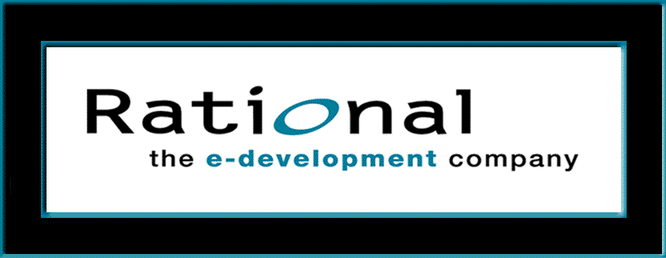
Requirements Management with Use Cases
Module 1: The Six Best Practices of Modern Software Engineering

Slide 2
Objectives
Identify Steps for Understanding and Solving Software Engineering Problems
Explain the Six Best Practices
Present the Rational Unified Process within the context of the Six Best Practices
Notes:
In this module, we describe recommended software development practices and give the reasons for these recommendations. We then show how the Rational Unified Process (RUP) is designed to help you implement the Best Practices.
The highlighted terms are the key terms and concepts introduced in this module.

Slide 3
The Business Problem
Software:
Increasingly more critical
Needs to be delivered faster
Needs to have quality
“We estimate only 26% of software projects will succeed.”
Standish Group
CHAOS Report
1998
But...
Notes:
Do not overstate the problems. Some people make it sound like all software projects are disasters. That is not the message we’re trying to convey.
Many software projects are successful, but not enough of them. We need to reduce our failure rate.
Software is being deployed in more and more business-critical applications -- providing key functionality within a spectrum of products, and automating essential operational processes. It’s getting more complex, yet we are being asked to create it both more rapidly and to a higher level of quality.
Not surprisingly, the failure rate is increasing. A few years ago, most studies indicated that half of all projects would fail to complete successfully. The Standish Group’s most recent estimate is that only a quarter will be completed on time and on budget.
Significant examples of these failures include:
AT&T. A software switching system failed and hindered long distance communication in the US for almost 24 hours. The resolution required a change to a single line of code.
Denver Airport. Software defects delayed the airport’s opening almost 9 months, at an estimated taxpayer cost of about 1/2 million dollars / day.
Further compounding the problem, businesses continue to demand increased productivity and quality with faster development and deployment. Additionally, the supply of qualified development personnel is not keeping pace with the demand. 1998 estimates of open software jobs range from 200,000 to 400,000. Economists predict that another million new programmers will be needed within the next nine years.

Slide 4
Steps in Problem Solving
Step 1 - Recognize the symptoms
Step 2 - Identify root causes
Step 3 - Fix the root causes
Notes:
We have a serious business problem: rapidly growing dependence on software that is increasingly more difficult to deliver. It’s a problem we must address methodically, step-by-step.
We start by examining symptoms. Directly attacking symptoms is often counterproductive, but they provide useful information about the underlying problem.
The next step is diagnosis: tracing symptoms to their underlying problems so that we can directly address them.

Slide 5
Symptoms of Software Development Problems
Inaccurate understanding of end-user needs
Inability to deal with changing requirements
Modules that don’t fit together
Software that’s hard to maintain or extend
Late discovery of serious project flaws
Poor software quality
Unacceptable software performance
No coordinated team effort
An unreliable build-and-release process
Notes:
These symptoms are readily observable in the real world. Just like in the medical world, it is not sufficient to treat the symptoms. One must address the root causes (as shown on the next page).
An example of treating the symptoms is addressing the second bullet by insisting that no changes to requirements be accepted after a certain date. This is unrealistic. Change will happen to the business environment regardless, and the result may be that users reject the system that is built since it has not adapted to their changing needs.
Encourage student interaction on this slide.
One possibility is to ask students for symptoms of problems they have observed, before you show the slide. You could then compare the students’ list to this list. Or you could show the list first and ask for additional symptoms that students have observed.
Producing quality software on time is very challenging; a large number obstacles and problems must be overcome. Problems are often first recognized by their symptoms. These are some all-too-common ones.
The reality is that we can’t stop change. We used to try to baseline requirements at the start of a project and then resist all changes to them. A better approach is to develop practices that allow us to manage change when it occurs, with minimal impact to the development process.
An example associated with software that’s hard to maintain or extend is the Year 2000 (Y2K) problem. The software itself has been unexpectedly successful, lasting well beyond its estimated end-of-life projections. But the software is very hard to modify since the Y2K problem is pervasive. It occurs throughout the software and each occurrence must be found and fixed individually.

Slide 6
Root Causes of Software Development Problems
Insufficient requirements management
Ambiguous and imprecise communications
Brittle architectures
Overwhelming complexity
Undetected inconsistencies among requirements, designs, and implementations
Insufficient testing
Subjective project status assessment
Delayed risk reduction due to waterfall development
Uncontrolled change propagation
Insufficient automation
Notes:
Do not trash waterfall development. It makes sense and is applied repeatedly in the iterative process we recommend. It just has to be applied to an increment rather than to the entire project.
These root causes have been determined by analyzing Rational’s experience in developing its software products together with the experience of Rational’s many customers. Common patterns and themes have been detected and are documented as these root causes and the best practices that address them.
Insufficient requirements management makes scope creep inevitable and seriously jeopardizes the development team’s ability to bring the project to a conclusion on time.
Brittle architectures are architectures that break easily in response to stress or requirements/technology changes. They typically provide no reusable components, nor are they based on a reusable framework.
Subjective project status assessment depends on subjective estimates of the level of “doneness”. This is often referred to as the “90% done, 90% remaining” phenomenon. In other words, the developers estimate that they are 90% done, but it takes 90% of project resources to get the rest of the way to 100% done.

Slide 7
Addressing Root Causes Eliminates the Problems
Symptoms
needs not met
requirements churn
modules don’t fit
hard to maintain
late discovery
poor quality
poor performance
colliding developers
build-and-release
Root Causes
insufficient requirements
ambiguous communications
brittle architectures
overwhelming complexity
undetected inconsistencies
poor testing
subjective assessment
waterfall development
uncontrolled change
insufficient automation
Best Practices
Develop Iteratively
Manage Requirements
Use Component Architectures
Model Visually (UML)
Continuously Verify Quality
Control Changes (UCM)
Notes:
Treat these root causes and you’ll eliminate the symptoms. Eliminate the symptoms, and you’ll be in a much better position to develop quality software in a repeatable and predictable fashion.
Best practices are a set of commercially proven approaches to software development, which, when used in combination, strike at the root causes of software development problems. These are so called “best practices”, not so such much because we can precisely quantify their value, but rather, because they are observed to be commonly used in industry by successful organizations.
These six best practices form the foundation of the Rational Unified Process. They are documented in The Rational Unified Process - An Introduction, by Philippe Kruchten (Addison-Wesley-Longman, 1998)
We don’t expect students to read this chart. It is an abstract view that shows the many to many relationships among the symptoms and root causes, and between the root causes and practices. One example highlights the many possible mappings between symptoms, root causes, and Best Practices.
Based on Rational’s 18 years of experience, and based on experience of others, here are the root causes. It’s OK to spend a few more minutes in this presentation making these points, because everything else, including RUP, is based on the fact that these Six Best Practices are the right ones.

Slide 8
What are Software Best Practices?
An organized and documented set of principles, methods, and processes that increase quality and productivity of software development.
Notes:
The Best Practices are a set of techniques for addressing the root causes of problems faced by today’s software development teams.

Slide 9
Practice 1: Develop Software Iteratively
Develop Iteratively
Manage Requirements
Use Component Architectures
Best
Practices
Model Visually
Continuously
Verify Quality
Control Change
Notes:
The first Best Practice is to Develop Iteratively.
We need to keep the concept of iterative development at a very high level in this module. It is easy to get bogged down in the many ramifications of iterative development.
Try just to get the concept across here. The Rational Unified Process Overview course covers this in more detail.

Slide 10
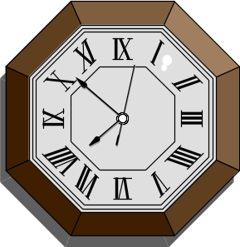
You Can’t Know Everything Initially
An initial design will likely be flawed with respect to its key requirements
Late-phase discovery of design defects results in costly over-runs and/or project cancellation
$$$
The time and money spent implementing a
faulty design are not recoverable
Notes:
Given the complexity of the systems we are building, there is no process or methodology that will guarantee a correct initial design.
Failure to discover such design problems until late in the development lifecycle is a major cause of project failure.
Not all requirements are initially known, and those that are known may be ambiguous or simply wrong. Some requirements that are initially accurate will become obsolete because the problem domain or competitive situation changes during development.
As Tom DeMarco says: “There are infinitely many ways to lose a day . . . but not even one way to get one back.” [Tom DeMarco, The Deadline: A Novel about Project Management, Dorset House, 1997.]
From Meta Fax 9/15/97:
“Our research shows over 30% of new software projects are canceled before completion (>$80B “loss”), and more than 50% of projects are 180%+ over budget ($59B “loss”). While large projects are more prone to cost overruns, medium-size/small projects are vulnerable to cancellation. The key reasons continue to be poor project planning and management, shortage of technical and project management expertise, lack of technology infrastructure, disinterested senior management, and inappropriate project teams.”

Slide 11
Waterfall Development Characteristics
Delays confirmation of critical risk resolution
Measures progress by assessing work-products that are poor predictors of time-to-completion
Delays and aggregates integration and testing
Precludes early deployment
Frequently results in major unplanned iterations
Waterfall Process
Requirements
analysis
Design
Code and unit test
Subsystem integration
System test
Notes:
Waterfall is conceptually straightforward because it produces a single deliverable. The fundamental problem of this approach is that it pushes risk forward in time, where it’s costly to undo mistakes from earlier phases. An initial design will likely be flawed with respect to its key requirements, and furthermore, the late discovery of design defects tends to result in costly overruns and/or project cancellation. The waterfall approach tends to mask the real risks to a project until it is too late to do anything meaningful about them.
To illustrate a problem with the waterfall model: Suppose you estimate that the project will take 2 years and it really takes 3 years. At the end of 2 years what do I have? Nothing useful works. I have nothing that could be delivered as an early (partial) release. Diagrams and models are great, but they can’t execute.

Slide 12
Conventional Software Process
Sequential activities:
Requirements Design Code Integration Test
100%
Integration
Begins
Late Design
Breakage
Development Progress
(% coded)
Original
Target Date
Project Schedule
Notes:
Software development progress over the project lifecycle typically proceeded without issue until the integration phase.
Requirements were first captured in complete detail in ad hoc text.
Then design documents were fully elaborated in ad hoc notations.
Then coding and unit testing of individual components was performed.
Then the components were compiled and linked together into a complete system. This integration activity was the first time that significant inconsistencies among components, (their interfaces and behavior) could be tangibly recognized. These inconsistencies, some of them extremely difficult to uncover, resulted from the ambiguity of early lifecycle artifacts. Getting the software to operate reliably enough to test its usefulness took much longer than planned. Budget and schedule pressure drove teams to shoehorn in the quickest fixes. Redesign was usually out of the question.
Then testing of system threads, usefulness, requirements compliance, and quality was performed through a series of releases until the software was judged adequate for the user.
90% of the time, the result was a software system that was late, over budget, fragile, and expensive to maintain.

Slide 13
Iterative Development Characteristics
Resolves major risks before making large investments
Enables early user feedback
Makes testing and integration continuous
Focuses project short-term objective milestones
Makes possible deployment of partial implementations
Iteration 1
Iteration 2
Iteration 3
R
R
R
D
D
D
C
C
C
I
I
I
T
T
T
T I M E
Notes:
Iterative processes were developed in response to these waterfall characteristics. With an iterative process, the waterfall steps are applied iteratively. Instead of developing the whole system in lock step, an increment (that is, a subset of system functionality) is selected and developed, then another increment, etc. The selection of the first increment to be developed is based on risk, the highest priority risks first. To address the selected risk(s), choose a subset of use cases. Develop the minimal set of use cases that will allow objective verification (i.e., through a set of executable tests) of the risks that you have chosen. Then select the next increment to address the next highest risk, and so on. Thus you apply the waterfall within each iteration and the system evolves incrementally.
In the iterative approach, the waterfall is applied to a single system increment at a time. Each iteration produces an executable.

Slide 14
Risk Profiles
Inception
Elaboration
Construction – Transition
High
Controlled Risk
Management Period
Project Risk Exposure
Iterative Project
Conventional (Waterfall)
Risk Profile
Project Risk Profile
Risk
Risk
Exploration
Resolution
Period
Period
Low
Project Lifecycle
Notes:
Iterative development produces the architecture first, allowing integration to occur “as the verification activity” of the design phase and design flaws to be detected and resolved earlier in the lifecycle. Continuous integration throughout the project replaces the big bang integration at the end of a project. Iterative development also provides much better insight into quality, because system characteristics that are largely inherent in the architecture (e.g., performance, fault tolerance, maintainability) are tangible earlier in the process. Thus issues are still correctable without jeopardizing target costs and schedules.

Slide 15
Iterative Development Produces an Executable
Requirements
Analysis & Design
Planning
Implementation
Initial
Planning
Management
Environment
Deployment
Evaluation
Test
Each iteration results in an executable release
Notes:
The earliest iterations address greatest risks. Each iteration produces an executable release. Each iteration includes integration and test.

Slide 16
Practice 2: Manage Requirements
Develop Iteratively
Manage Requirements
Use Component Architectures
Best
Practices
Model Visually
Continuously
Verify Quality
Control Change
Notes:
A report from the Standish Group confirms that a distinct minority of software development projects is completed on-time and on-budget. In their report, the success rate was only 16.2%, while challenged projects (operational, but late and over-budget) accounted for 52.7%. Impaired projects (canceled) accounted for 31.1%. These failures are attributed to poor requirements management, incorrect definition of requirements from the start of the project, and poor requirements management throughout the development lifecycle. (Source: Chaos Report, http://www.standishgroup.com).
You can generate discussion with the students concerning how they get requirements and how they manage them now.
Students who want to know in detail how to manage requirements should take the Requirements Management with Use Cases course.

Slide 17
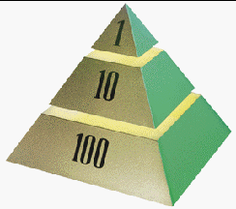
Requirements Management
A systematic approach to
  eliciting
  organizing
  documenting
  and managing
the changing requirements of a software application.

Slide 18
Aspects of Requirements Management
Analyze the Problem
Understand User Needs
Define the System
Manage Scope
Refine the System Definition
Build the Right System

Slide 19
Map of the Territory
Problem
Problem Space
Needs
Solution Space
Features
Traceability
The Product To Be Built
Use Cases and Software
Requirements
Test Procedures
Design
User Docs
Notes:
Managing requirements involves the translation of stakeholder requests into a set of key stakeholder needs and system features. These in turn are detailed into specifications for functional and non-functional requirements. Detailed specifications are translated into test procedures, design, and user documentation.
Traceability allows us to:
Assess the project impact of a change in a requirement
Assess the impact of a failure of a test on requirements (i.e., if test fails the requirement may not be satisfied)
Manage the scope of the project
Verify that all requirements of the system are fulfilled by the implementation
Verify that the application does only what it was intended to do
Manage change

Slide 20
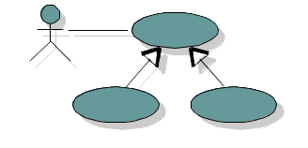
Manage Changing Requirements
Requirements are dynamic --
They will change during development
Establish the baseline - elicit, organize, and document functionality and constraints
Evaluate changes and determine their impact
Track and document tradeoffs and decisions
Notes:
The challenge with managing the requirements of a software-intensive system is that its requirements are quite dynamic: you must expect them to change over the life of a software project. Furthermore, identifying a system’s true requirements – those that weigh most heavily upon the system’s economic and technical goals – is a continuous process. Except for the most trivial system, it is impossible to completely and exhaustively state a system’s requirements prior to the start of development. Indeed, the mere presence of a new or evolving system tends to change a user’s own understanding of the system’s requirements. Change cannot be stopped, but it can be managed.

Slide 21
Practice 3: Use Component Architectures
Develop Iteratively
Manage Requirements
Use Component Architectures
Best
Practices
Model Visually
Continuously
Verify Quality
Control Change
Notes:
Software architecture is the development product that gives the highest return on investment with respect to quality, schedule, and cost, according to the authors of Software Architecture in Practice. The Software Engineering Institute (SEI) has an effort underway called the Architecture Tradeoff Analysis (ATA) Initiative to focus on software architecture, a discipline much misunderstood in the software industry. The SEI has been evaluating software architectures for some time and would like to see architecture evaluation in wider use. By performing architecture evaluations, AT&T reports a 10% productivity increase (from news@sei, Vol. 1, No. 2).

Slide 22
Benefits of a Focus on Architecture
Basis for reuse
  Component reuse
  Architecture reuse
Basis for project management
  Focus for early iterations
  Planning
  Staffing
Intellectual control
  Manage complexity
  Maintain integrity
Notes:
Architecture is a part of design. Architecture is about making decisions on how the system will be built. But it is not all of the design. It stops at the major abstractions, the major elements; in other words, the elements that have some pervasive and long-lasting effect on the qualities of the system, namely its ability to evolve, its performance.
A software system’s architecture is perhaps the most important aspect that can be used to control the iterative and incremental development of a system throughout its lifecycle.
An example of an architectural concern is an integration risk. For example, does database D work properly with operating system Y? Another example is performance risk. Can we compute the trajectory of the aircraft in the time allowed?
Because students vary in how familiar they are with the concept of architecture applied to software, it is best to get a sense of this from the students before beginning this section. If they are fairly unfamiliar, it helps to use the analogy to buildings or civil engineering. The more complex the building, the more critical a good architecture is. The longer you want the building to be useful, the more effort and expense you will put into the architecture. And in both of these cases, the choice of architect is critical.

Slide 23
Purpose of a Component-Based Architecture
Intellectual control
  Manage complexity
  Maintain integrity
Basis for reuse
  Component reuse
  Architecture reuse
  Line-of-product
Basis for project management
  Planning
  Staffing
  Delivery
Application-
specific
Business-
specific
Middleware
System-
software
Component-based Architecture with
layers
Notes:
A software component can be defined as a nontrivial piece of software -- a module, a package, or a subsystem -- that fulfills a clear function, has a clear boundary, and can be integrated in a well-defined architecture. It is the physical realization of an abstraction in your design.
Components come from different avenues:
In defining a very modular architecture, you identify, isolate, design, develop, and test well-formed components. These components can be individually tested and gradually integrated to form the whole system.
Furthermore, some of these components can be developed to be reusable, especially the components that provide common solutions to a wide range of common problems. These reusable components, which may be larger than just collections of utilities or class libraries, form the basis of reuse within an organization, increasing overall software productivity and quality.
More recently the advent of commercially successful component infrastructures such as CORBA, the Internet, ActiveX or JavaBeans, triggers a whole industry of off-the-shelf components for various domains, allowing you to buy and integrate components rather than developing them all in-house.

Slide 24
Resilient, Component-Based Architectures
Resilient
  Meets current and future requirements
  Improves extensibility
  Enables reuse
  Encapsulates system dependencies
Component-based
  Reuse or customize components
  Select from commercially-available components
  Evolve existing software incrementally
Notes:
The most import property of an architecture is resilience -- flexibility in the face of change. To achieve it, architects must anticipate evolution in both the problem domain and implementation technologies to produce a design that can gracefully accommodate such changes. Key techniques are abstraction, encapsulation, and object-oriented analysis and design. The result is applications are fundamentally more maintainable and extensible.
The emergence of commercial component infrastructures such as Microsoft’s COM, the OMG’s CORBA, and Sun’s Enterprise Java Beans offer well-supported platforms with which to assemble component-based architectures. Commercialization of these frameworks has created an industry supplying off-the-shelf components, permitting build vs. buy decisions.
Component-based architectures enable economically significant re-use. In contrast with re-use of individual modules, significant design elements -- typically frameworks for important domain or enterprise abstractions -- can be applied to multiple related applications.
You can encourage discussion at this point. A single requirement, such as throughput or fault tolerance, affects almost every design decision made on a system. For example, if building a transportation system (such as for trains), it is likely that they will have a “no single point of failure” requirement that must be in every developers mind every step of the way. Many architectural mechanisms will be developed to accommodate that single requirement. If you can get some students to describe their architectural challenges, this point is more effectively driven home.

Slide 25
Example: Component-Based Architecture
Lead Tracking
Functions
Licensing
Functions
User Interface
Mechanisms
Customer
Product
License
Purchased
Existing
New
Oracle
Vantive
Notes:
Here’s an IS application with an architecture based on components.
Access to the databases is mediated through purchased components.
Built on this are home-brew components that capture the organization’s semantics and business rules for Customers and Products.
There’s a set of UI mechanisms, some of which were purchased, and a user interface for Lead Tracking.
Suppose we wish to institute and manage software licensing.
First, we need a component to capture the business rules for a License. Access requires a new GUI. As we’re implementing the GUI, we encounter the need for additional UI Mechanism capabilities, satisfied by re-using an existing component and purchasing a new one.
This example should be familiar with most IS people. Even people who build embedded software should be able to relate to the infrastructure software within their own companies.
Most companies today use off-the-shelf purchased packages for as much of the functionality as possible, and fill in where the products are deficient. This example derives from an internal IT project at Rational.
Animation notes: Initially, all but the licensing application is shown. Explain that it is component-based, some components purchased and some built. Then suggest we need to manage licensing and click the mouse to show the additional components and how existing ones are reused.
The animation is based on the student notes.

Slide 26
Practice 4: Visually Model Software
Develop Iteratively
Manage Requirements
Use Component Architectures
Best
Practices
Model Visually (UML)
Continuously
Verify Quality
Control Change
Notes:
The fourth Best Practice is to visually model your application.
You may wish to lead a discussion about models and why we build models in general. For example, before building a bridge, the architect builds a model and has it reviewed.
We build models because the thing we are studying is so complex that no one can understand all of the details. A model leaves out all the details that are unimportant. It facilitates our understanding of the larger issues.

Slide 27
Capture Structure and Behavior in Models
Capture the structure and behavior of architectures and components
Show how the elements of the system fit together
Maintain consistency between a design and its implementation
Promote unambiguous communication
Notes:
A model is a simplification of reality that provides a complete description of a system from a particular perspective. We build models so that we can better understand the system we are modeling; we build models of complex systems because we cannot comprehend any such system in its entirety.
Modeling is important because it helps the development team visualize, specify, construct, and document the structure and behavior of a system’s architecture. Using a standard modeling language such as the UML (the Unified Modeling Language), different members of the development team can communicate their decisions unambiguously to one another.
Using visual modeling tools facilitates the management of these models, letting you hide or expose details as necessary. Visual modeling also helps you maintain consistency among a system’s artifacts: its requirements, designs, and implementations. In short, visual modeling helps improve a team’s ability to manage software complexity.
Visual modeling for software is analogous to blueprints for construction.

Slide 28

Representing Architecture: the UML
The UML is a language for
  Visualizing
  Specifying
  Constructing
  Documenting
the artifacts of a software-intensive system
Notes:
To increase comprehension, use a common language like the Unified Modeling Language to express models. The UML has been adopted as an industry standard. It is platform-independent. It defines a graphical language for presenting models and defines the semantics for each graphical element.
Don’t go into detail on the UML here. We discuss it in more depth in those courses where more detail is relevant.

Slide 29
Visual Modeling with Unified Modeling Language
Multiple views
Precise syntax and semantics
Class
Diagrams
Use-Case
Diagrams
Object
Diagrams
Sequence
Diagrams
Collaboration
Diagrams
Component
Diagrams
Models
Statechart
Diagrams
Deployment
Diagrams
Static Diagrams
Activity
Diagrams
Dynamic Diagrams
Notes:
In building a visual model of a system, many different diagrams are needed to represent different views of the system. The UML provides a rich notation for visualizing our models. This includes the following key diagrams:
Use-Case diagrams to illustrate user interactions with the system
Class diagrams to illustrate logical structure
Object diagrams to illustrate objects and links
State diagrams to illustrate behavior
Component diagrams to illustrate physical structure of the software
Deployment diagrams to show the mapping of software to hardware configurations
Interaction diagrams (i.e., collaboration and sequence diagrams) to illustrate behavior
Activity diagrams to illustrate flows of events
The UML emphasizes a graphical language for representing models, but provides little/no guidance on when and how to use these diagrams. This is an area where the RUP helps. It describes the kinds of project artifacts needed, including diagrams, and puts them in the context of an overall project plan.

Slide 30
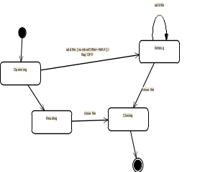
Visual Modeling Using UML Diagrams
Use-case
diagram
Statechart
diagram
Class diagram
Actor A
Use Case 1
FileMgr
add( )
DocumentList
Document
Actor B
fetchDoc( )
delete( )
name : int
sortByName( )
docid : int
numField : int
get( )
read() fill the
Use Case 2
open( )
code..
close( )
FileList
read( )
fList
sortFileList( )
create( )
add( )
fillDocument( )
delete( )
1
Use Case 3
1
rep
File
Deployment
diagram
Repository
(from Persistence)
read( )
GrpFile
name : char * = 0
read( )
readDoc( )
open( )
Collaboration diagram
readFile( )
create( )
fillFile( )
9: sortByName ( )
DocumentList
Repository
1: Doc view request ( )
mainWnd : MainWnd
FileManager
Window95
Windows95
Windows95
L
2: fetchDoc( )
Document
¹®¼­°ü¸®
4: create ( )
gFile : GrpFile
Å¬¶óÀÌ¾ðÆ®.EXE
¹®¼­°ü¸® ¾ÖÇÃ¸´
8: fillFile ( )
Windows
user : Clerk
fileMgr : FileMgr
NT
Solaris
3: create ( )
GraphicFile
¹®¼­°ü¸® ¿£Áø.EXE
Alpha
6: fillDocument ( )
File
FileList
Windows
ÀÀ¿ë¼­¹ö.EXE
UNIX
7: readFile ( )
NT
IBM
repository : Repository
5: readDoc ( )
document : Document
Mainframe
Component
diagram
µ¥ÀÌÅ¸º£ÀÌ½º¼­¹ö
mainWnd
fileMgr :
document :
gFile
repository
user
FileMgr
Document
Target
System
Æ¯Á¤¹®¼­¿¡ ´ëÇÑ º¸±â¸¦
1: Doc view request ( )
»ç¿ëÀÚ°¡ ¿äÃ»ÇÑ´Ù.
2: fetchDoc( )
3: create ( )
4: create ( )
5: readDoc ( )
È­ÀÏ°ü¸®ÀÚ´Â ÀÐ¾î¿Â
6: fillDocument ( )
Forward and Reverse Engineering
¹®¼­ÀÇ Á¤º¸¸¦ ÇØ´ç ¹®¼­
°´Ã¼¿¡ ¼³Á¤À» ¿äÃ»ÇÑ´Ù.
7: readFile ( )
È­¸é °´Ã¼´Â ÀÐ¾îµéÀÎ
9: sortByName ( )
8: fillFile ( )
°´Ã¼µé¿¡ ´ëÇØ ÀÌ¸§º°·Î
Á¤·ÄÀ» ½ÃÄÑ È­¸é¿¡
º¸¿©ÁØ´Ù.
Sequence
diagram
Notes:
The point to be made is that the UML is the language we use to visually model. Since it is a widely-adopted standard, it facilitates the understanding and communication of the visual models we create.
Activity diagrams are not shown on the slide. Activity diagrams can be used to model workflows in business process engineering.
Visual modeling with the UML makes an application’s architecture tangible, permitting us to assess it in multiple dimensions. How portable is it? Can it exploit expected advances in parallel processing? How might we modify it to support a family of applications? We’ve discussed the importance of architectural resilience and quality. The UML enables us to evaluate these key characteristics during early iterations -- at a point when design defects can be corrected before threatening project success.
Advances in forward and reverse engineering techniques permit changes to an application’s model to be automatically reflected in its source code, and changes to its source code to be automatically reflected in its model. This is critical when using an iterative process, where we expect such changes with each iteration.

Slide 31



Visual Modeling Maintains Architectural Integrity
Detect and assess architectural changes
Communicate accepted architectural changes
Synchronize your model and source code during every iteration
Sub Systems
Visual Modeling
raises the level
of abstraction
Classes
Code
Notes:
Visual modeling addresses most of the root causes we have identified. The wide range of diagramming techniques provided by the UML can be used to communicate software development decisions unambiguously and therefore to expose inconsistencies and incomplete information early in the lifecycle. The wide range of diagramming techniques demands good automated tools to support the creation and maintenance of UML diagrams and automated analysis of inconsistencies among them.

Slide 32
Practice 5: Continuously Verify Software Quality
Develop Iteratively
Manage Requirements
Use Component Architectures
Best
Practices
Model Visually
Continuously Verify Quality
Control Change
Notes:
Quality, as used within the Rational Unified Process, is defined as "The characteristic of having demonstrated the achievement of producing a product which meets or exceeds agreed upon requirements, as measured by agreed upon measures and criteria, and is produced by an agreed upon process." Given this definition, achieving quality is not simply "meeting requirements" or producing a product that meets user needs and expectations. Quality also includes identifying the measures and criteria (to demonstrate the achievement of quality), and the implementation of a process to ensure that the resulting product has achieved the desired degree of quality (and can be repeated and managed).
In many organizations, software testing accounts for 30% to 50% of software development costs. Yet most people believe that software is not well-tested before it is delivered. This contradiction is rooted in two clear facts. First, testing software is enormously difficult. The different ways a given program can behave are almost infinite. Second, testing is typically done without a clear methodology and without the required automation or tool support. While the complexity of software makes complete testing an impossible goal, a well-conceived methodology, and use of state-of-the-art tools, can greatly improve the productivity and effectiveness of the software testing.
Do not assume that verifying quality and testing are synonymous. While testing is used to do the bulk of verifying quality, there are other techniques that we will mention.

Slide 33
Continuously Verify Your Software’s Quality
Software problems are 100 to 1000 times more costly to find and repair after deployment
Cost
Inception Elaboration Construction Transition
Notes:
Many people remember Barry Boehm’s groundbreaking work in Software Economics where he quantified the relative expense to fix a bug at different times in the development lifecycle. Be cautious, however, since his work was based on the waterfall model, not an iterative development model.
The iterative model changes fundamentally how and when we test.
This principal is driven by a fundamental and well-known property of software development: it’s a lot less expensive to correct defects during development than to correct them after deployment.
Tests for key scenarios ensure that all requirements are properly implemented
Poor application performance hurts as much as poor reliability
Verify software reliability -- memory leaks, bottlenecks
Test every iteration -- automate test!

Slide 34
Dimensions of Software Quality
Type
Why?
How?
Functionality
Reliability
Performance
Does my application do what’s required?
Does my application respond acceptably?
Does the system perform under production load?
Test cases for each implemented use-case instance.
Automated test generation. Code instrumentation in conjunction with test cases.
Check application performance for each implemented use case instance.
Test performance of all use cases under expected and worst-case, multi-user load.
Notes:
Verifying a system’s functionality involves creating tests for each key use-case instance. You can assess a system’s functionality by asking what scenarios failed and where, and what scenarios and corresponding code have not yet been exercised.
Effective reliability testing requires specialized tools. Some verification is done by compilers and analysis tools; some through instrumentation.
The two most effective techniques are:
Automated test script generation to provide broad coverage of the application under test
Instrumented regression test script execution to allow specialized tools to run repeatedly against standard use case instances.
Detection via debugging of memory leaks in C++, for example, is unpredictable. Tools that analyze the code to detect leaks are much more effective.
Performance testing checks that the target system continues to work functionally and reliably under production load. Modern software architectures present special challenges. An application may meet its performance requirements, yet the overall system performance may be deficient. It may be impossible to test all configurations in which the system will be deployed. The key to effective performance testing is the definition of appropriate workloads that correctly model the user population and activity.
These types of software verification can be part of every iteration in the lifecycle.

Slide 35
Iterative Development Benefits Testing
Iteration X
Testing:
  Starts earlier
  Is continuous
Iteration X + 1
Require-
ments
Capture
Analysis
and Design
Implementation
Build
Build
Project
Plan
Test
Design
Test
Implement Test
Exec.
Exec.
Planning
Evaluate Test
Iteration X + 2
Result:
  Higher Quality
  Lower Risk
Notes:
This iterative approach makes regression testing necessary. Early iterations make it possible to begin test development early in the lifecycle. Then, most tests of iteration X are used as regression tests in iteration X+1. In iteration X+2, you would use most tests from iteration X and iteration X+1 as regression tests, and the same principle would be followed in subsequent iterations. Because the same test is repeated several times, it is well worth the effort to automate the tests.

Slide 36
Test Each Iteration: Functionality & Performance
Iteration 1
Iteration 2
Iteration 3
Iteration 4
UML Model and
Implementation
Test Suite 1
Test Suite 2
Test Suite 3
Test Suite 4
Tests
Notes:
In each iteration, automated tests are created that test the requirements addressed in that iteration. As new requirements are added in subsequent iterations, new tests are generated and run. At times, a requirement many be changed in a later iteration. In that case, the tests associated with the changed requirement may be modified or simply regenerated by an automated tool.
The point to be made on this slide is that it is important to start automating test in the earliest iterations. Some people think that you don’t need to automate testing until the later iterations when requirements are pretty stable. Even if you expect that the requirements, and hence the tests, are still unstable, it is still more efficient to automate.

Slide 37
Automation Reduces Testing Time and Effort
One Manual Test Cycle
13,000 Tests 2 Weeks 6 People
Test
Automation
13,000 Tests
6 hours
1 Person
Run More Tests More Often
Notes:
While most agree that continuous testing is ideal, until automated test tools became available, it was not feasible. Test setup, execution, and evaluation just took too much time. With the reduction in time and effort to perform testing with automated tools, an iterative approach based on continuous testing became feasible.
The example shown on the slide is derived from actual results from a real-world customer. Before automating their test program, they ran 13,000 tests in two weeks using 6 testing people. After automating their tests, they could run the same set of tests with just one person in only 6 hours! The really interesting result of all of this is that, rather than just realizing their cost savings and moving on, this customer found themselves running the tests over and over again. They were thus able to verify that they were not introducing errors into their product as they made enhancements.
The point of this slide is that test automation is necessary to make true iterative development feasible. Manual testing is too slow and too error-prone. Iterations would take too long.
With automation, tests can be rerun rapidly and hence all of the regression testing needed in an iterative environment is feasible.

Slide 38
Practice 6: Control Changes to Software
Develop Iteratively
Manage Requirements
Use Component Architectures
Best
Practices
Model Visually
Continuously
Verify Quality
Control Change (UCM)
Notes:
As we indicated earlier, we cannot stop change from being introduced into our project. However, we must control how and when changes are introduced into project artifacts and who introduces the changes. We also must synchronize change across development teams and locations.
Unified Change Management (UCM) is Rational Software's approach to managing change in software system development, from requirements to release.
Control of change is especially important in an iterative project. Artifacts are generally produced incrementally. At the end of each iteration, another increment is put under configuration control. Otherwise, no progress will be made and iterations will not converge on a complete and consistent system. We are not just talking about changes to source code, but also to requirements, models, documents, plans, and all development artifacts.

Slide 39

What Do You Want to Control?
Control, track, and monitor changes to enable iterative development
Establish secure workspaces for each developer
Automate integration and build management
Workspace
Management
Parallel
Development
CM is more than just check-in and check-out
REPORT
ALERT
Build
Management
Process
Integration
Notes:
Establishing secure workspaces for each developer provides isolation from changes made in other workspaces, and control of all software artifacts -- models, code, docs, etc.

Slide 40
Controlling Parallel Development
Multiple developers
Multiple teams
Multiple sites
Multiple iterations
Multiple releases
Multiple projects
Multiple platforms
Notes:
A key challenge to developing software-intensive systems is the need to cope with multiple developers, organized into different teams, possibly at different sites, all working together on multiple iterations, releases, products, and platforms. In the absence of disciplined control, the development process rapidly degrades into chaos. Progress can come to a stop.
Three common problems that result are:
Simultaneous update -- When two or more workers separately modify the same artifact, the last one to make changes destroys the work of the former.
Limited notification -- When a problem is fixed in shared artifacts, some of the users are not notified of the change.
Multiple versions -- With iterative development, it would not be unusual to have multiple versions of an artifact in different stages of development at the same time. For example, one release is in customer use, one is in test, and one is still in development. If a problem is identified in any one of the versions, the fix must be propagated among all of them and change control can lead to chaos and halt progress.
If possible, use an example from your experience to illustrate what can go wrong when doing parallel development without adequate controls. For example, two programmers making simultaneous updates to the same component. Or a very important test failing in front of a customer because the wrong version of the test case was run.

Slide 41
Configuration Management Concepts
Decompose the architecture into subsystems
Assign subsystems to a team
Establish secure workspaces for each developer
Establish an integration workspace
Establish an enforceable change control mechanism
Release a tested baseline at the completion of each iteration
Notes:
To coordinate developers and teams, we recommend:
Audited baselines include an accurate bill-of-materials that enables one to determine the exact content of a release.
Secure workspaces for each developer provide
Isolation from changes made in other workspaces
Control all software artifacts -- models, code, docs, etc.
Change control supports all other Best Practices.
Develop iteratively: Without change control, iterations can degrade into infinite loops. We can track the artifacts baselined at the end of each iteration.
Manage requirements: To manage requirements, we must know the current baseline, and identify and control all changes to the baseline. For each proposed change, an impact assessment is made before the change is approved for incorporation.
Use component architectures: In order to reuse a component, one must locate all the related artifacts, such as models, documentation, test suites, etc.
Model visually: The design model is a key artifact of the development process and must be controlled. Portions of the model are developed in each iteration, so an increment of the model is baselined in each iteration.
Continuously verify quality: The results of every test run must be traceable to the specific versions of all artifacts involved, including source code, data bases, test cases, etc.

Slide 42
Change Request Management Concepts
Change requests come from many sources throughout the product lifecycle
Approved Decisions
Customer and
End-User Inputs
Vision
New Feature
Marketing
Require. & Use Cases
New Requirement
Change Control
Process
Developer inputs
Fix Bug
Code
Testers inputs
Tests
Change Request
System
Notes:
Change comes from many sources at all times during development. We must capture these changes so that we can asses impact BEFORE changes are implemented.
Resource allocation should be driven by key change attributes such as:
- Value to prospective and current customers
- Return on investment
- Market share and competitive position
- Impact on design, implementation, documentation, test

Slide 43
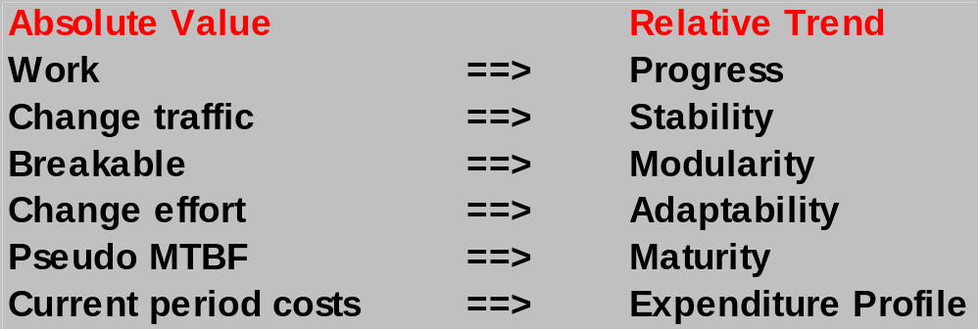
Configuration Status Accounting (Measurement)
Trends with respect to time are important
  Absolute value at any instant is less important
Notes:
Configuration Status Accounting (Measurement) – is used to describe the ‘state’ of the product based on the type, number, rate, and severity of defects found, and fixed, during the course of product development. Metrics derived under this aspect, either through audits or raw data, are useful in determining the overall completeness status of the project.
The primary themes of Rational’s iterative development process tackle the central management issues of complex software:
Managing risks
Getting the design right
Reducing the complexity of the developed system
Making software progress and quality tangible
Automating the overhead/bookkeeping activities and streamlining the productivity of creating, maintaining, and assessing intellectual products
We cannot manage what we cannot measure. The purpose of software metrics is to objectively measure the activities and products of the software development/integration process.
These metrics have been proven in practice on real projects using iterative development.
Metrics values provide some insight, but trends provide a more important perspective.

Slide 44
Unified Change Management
Management across the lifecycle
  System
  Project Management
Activity-Based Management
  Tasks
  Defects
  Enhancements
Progress Tracking
  Charts
  Reports
Notes:
On support for UCM in RUP:
The CM concepts described in UCM are covered in RUP by the following workflow details:
Create Project Environments,
Change and Deliver Configuration Items, and
Manage Baselines and Releases.
UCM does not cover the RUP activities described in the workflows:
Monitor and Report Configuration Status, and
Manage Change Requests.
The activities described in the RUP workflow detail:
Plan Project Configuration and Change Control are at a higher level of abstraction than the notion of a project described in UCM. However, UCM does cover the fact that policies need to be set, and that there is a CM process to be followed to ensure that all project artifacts are maintained under configuration control.

Slide 45
Best Practices Reinforce Each Other
Develop Iteratively
Manage Requirements
Ensures users involved
as requirements evolve
Use Component Architectures
Validates architectural
decisions early on
Best
Practices
Model Visually (UML)
Addresses complexity of
design/implementation incrementally
Continuously Verify Quality
Measures quality early and often
Control Changes (UCM)
Evolves baselines incrementally
Notes:
In the case of our Six Best Practices, the whole is much greater than the sum of the parts. Each of the Best Practices reinforces and, in some cases, enables the others. The slide shows just one example: how iterative development leverages the other five Best Practices. However, each of the other five practices also enhances iterative development. For example, iterative development done without adequate requirements management can easily fail to converge on a solution. Requirements change at will, users can’t agree, and the iterations can go on forever. When requirements are managed, this is less likely to happen. Changes to requirements are visible and the impact to the development process assessed before they are accepted. Convergence on a stable set of requirements is assured. Similarly, each pair of Best Practices provides mutual support. Hence, although it is possible to use one Best Practice without the others, it is not recommended since the resulting benefits will be much less.
This slide may be confusing unless it is explained properly. We have discussed each Best Practice individually in this module. This slide is intended to illustrate how the Best Practices used together provide much more benefit than each individually. The slide only illustrates how ONE of the Best Practices (Develop Iteratively) supports the others. How others interact might make a good discussion point for the students. For example, how do Control Changes and Continuously Verify Quality relate? Well, there is no point in running a test against an unknown configuration and no point in writing a defect against an unknown baseline. Similarly, there is no point in controlling changes until you have reached a stable level of quality in a product.

Slide 46

Teams Need Process to Build a System
Team-Based
Development
Modeling
Language
Unified
Process
Notes:
This slide is establishing the need for something beyond the UML. Some students may think: If I know the UML, I’m done. I don’t need a process. But we will establish that the UML, while a good and necessary first step, is not everything that is needed.
The UML provides a standard for the artifacts of development (semantic models, syntactic notation, and diagrams): the things that must be controlled and exchanged. But the UML is not a standard for the development process.
Despite all of the value that a common modeling language brings, you cannot achieve successful development of today’s complex systems solely by the use of the UML. Successful development also requires employing an equally robust development process.

Slide 47
Why Have a Process?
Provides guidelines for efficient development of quality software
Reduces risk and increases predictability
Promotes a common vision and culture
Captures and institutionalizes best practices
Notes:
The CMM has five levels of maturity: Each maturity level is composed of Key Process Areas (KPAs), and each KPA identifies a cluster of related activities.
Level-2 KPAs are:
Requirements Management
Software Project Planning
Software Project Tracking and Oversight
Software Subcontract Management
Software Quality Assurance
Software Configuration Management
Level-3 KPAs are:
Organization Process Focus
Organization Process Definition
Training Program
Integrated Software Management
Software Product Engineering
Inter-group Coordination
Peer Reviews

Slide 48
Rational Unified Process Implements Best Practices
Develop Iteratively
Manage Requirements
Use Component Architectures
Model Visually
Continuously
Verify Quality
Control Change
Notes:
The Rational Unified Process is a generic business process for object-oriented software engineering. It describes a family of related software engineering processes sharing a common structure, a common process architecture. It provides a disciplined approach to assigning tasks and responsibilities within a development organization. Its goal is to ensure the production of high-quality software that meets the needs of its end users, within a predictable schedule and budget. The Rational Unified Process captures the best practices in modern software development in a form that can be adapted for a wide range of projects and organizations.

Slide 49
Achieving Best Practices through...
An Iterative Approach
Guidance for activities and work products (artifacts)
Process focus on architecture
Use cases which drive design and implementation
Models which abstract the system
Requirements
Analysis & Design
Implementation
Test
Configuration &
Change Management
Notes:
Examples:
The dynamic structure (phases and iterations) of the Rational Unified Process create the basis of iterative development.
The Project Management Workflow describes how to set up and execute a project using phases and iterations.
You use the Use-Case Model of the Requirements Workflow and the Risk List to determine what functionality you implement in an iteration.
The Workflow Details of the Requirement Workflow show the activities and artifacts that make requirements management possible.
The iterative approach allows you to progressively identify components, decide which one to develop, which one to reuse, and which one to buy.
The Unified Modeling Language (UML) used in the process represents the basis of Visual Modeling and has become the defacto modeling language standard.
The focus on software architecture allows you to articulate the structure: the components and the ways in which they integrate, the fundamental mechanisms and patterns by which they interact.

Slide 50
A Team-Based Definition of Process
A process defines Who is doing What, When and How to reach a certain goal.
New or changed
requirements
Software Engineering
Process
New or changed
system
Notes:
It can be very difficult to explain what a process is, if people aren’t already familiar with it. An informal example most people can relate to is the process of balancing a checkbook at the end of the month. Most of us have developed a process we use -- the same steps every month. It shortens the time required to accomplish the task and ensures that we don’t forget any steps. The same applies to a software engineering process. We want it to be repeatable and ensure that all required tasks are accomplished when required. Of course, a software engineering process is much more complex than balancing a checkbook and there is a tremendous amount of information contained in the RUP.

Slide 51
Practical Support
Requirements Management
Visual Modeling
Automated Testing
Change Management
Develop Iteratively
Manage Requirements
Use Component Architectures
Model Visually (UML)
Continuously Verify Quality
Control Changes (UCM)
Tool Specific Guidance
Product Leadership
Best Practices
Process Guidance
Notes:
The Rational Unified Process shows how you can apply best practices of software engineering, and how you can use tools to automate your software engineering process.

Slide 52
Process Structure - Lifecycle Phases
Inception
Elaboration
Construction
Transition
time
The Rational Unified Process has four phases:
  Inception - Define the scope of project
  Elaboration - Plan project, specify features, baseline architecture
  Construction - Build the product
  Transition - Transition the product into end user community
Notes:
The student notes are quite extensive. There is no need to go into that much detail in class. The important thing is to understand how the RUP uses phases to organize the lifecycle.
You can also mention that we deliberately chose names that do not match the waterfall names (analysis, design, implementation, and test) to emphasize that they are NOT the same as the waterfall phases.
Some ways of describing the phases in common terminology:
Inception -- bid and proposal
Elaboration -- Building blueprints
Construction -- I think I’m done
Transition -- how do users react?
During Inception, we define the scope of the project, what is included, and what is not. We do this by identifying all the actors and use cases, and by drafting the most essential use cases (usually approximately 20% of the complete model). A business plan is developed to determine whether resources should be committed to the project.
During Elaboration, we focus on two things: get a good grasp of the requirements (80% complete) and establish an architectural baseline. If we have a good grasp of the requirements and the architecture, we can eliminate a lot of the risks and will have a good idea what amount of work remains to be done. We can make detailed cost/resource estimations at the end of Elaboration.
During Construction, we build the product in several iterations up to a beta release.
During Transition, we transition the product to the end user and focus on end user training, installation, and support.
The amount of time spent in each phase varies. For a very complex project with a lot of technical unknowns and unclear requirements, Elaboration may include 3-5 iterations. For a very simple project, where requirements are known and the architecture is simple, Elaboration may include only a single iteration.

Slide 53
Phase Boundaries Mark Major Milestones
Inception
Elaboration
Construction
Transition
time
Lifecycle
Objective
Milestone
Lifecycle
Architecture
Milestone
Initial Operational
Capability
Milestone
Product
Release
Notes:
The student notes are extensive and there is no need to go into detail with each milestone. The most important point to get across is that there are formal milestones marking major decision points with the RUP lifecycle just like there is in the waterfall.
The criteria listed in the student notes are extensive because they are thorough. However, only one or two of the criteria at each point are really important. The ones to emphasize are:
LCO: scope agreed upon and risks understood and reasonable
LCA: high risks addressed and architecture stable
IOC: product is complete and quality acceptable
At each of the major milestones, we review the project and decide whether to proceed with the project as planned, to abort the project, or to revise it. The criteria used to make this decision vary by phase.
The evaluation criteria for the inception phase (LCO) include: stakeholder concurrence on scope definition and cost/schedule estimates; requirements understanding as evidenced by the fidelity of the primary use cases; credibility of cost/schedule estimates, priorities, risks, and development process; depth and breadth of any architectural prototype; actual expenditures versus planned expenditures.
The evaluation criteria for the elaboration phase (LCA) include: stability of the product vision and architecture; resolution of major risk elements; adequate planning and reasonable estimates for project completion; stakeholder acceptance of the product vision and project plan; acceptable expenditure level.
The evaluation criteria for the construction phase (IOC) include: stability and maturity of the product release (i.e., is it ready to be deployed?); readiness of the stakeholders for the transition; acceptable expenditure level.
At the end of the transition phase, we decide whether to release the product. We base this primarily on the level of user satisfaction achieved during the transition phase. Often this milestone coincides with the initiation of another development cycle to improve or enhance the product. In many cases, this new development cycle may already be underway.

Slide 54
Iterations and Phases
Inception
Elaboration
Construction
Transition
Preliminary
Iteration
Architect.
Iteration
Architect.
Iteration
Devel.
Iteration
Devel.
Iteration
Devel.
Iteration
Transition
Iteration
Transition
Iteration
Minor Milestones: Releases
An iteration is a distinct sequence of activities based on an established plan and evaluation criteria, resulting in an executable release (internal or external).
Notes:
Within each phase, there is a series of iterations. The number of iterations per phase will vary. Each iteration results in an executable release encompassing larger and larger subsets of the final application.
An internal release is kept within the development environment and (optionally) demonstrated to the stakeholder community. We provide stakeholders (usually users) with an external release for installation in their environment. External releases are much more expensive (they require user documentation and technical support) and normally occur only during the transition phase.
The end of an iteration marks a minor milestone. At this point, we assess technical results and revise future plans as necessary.

Slide 55
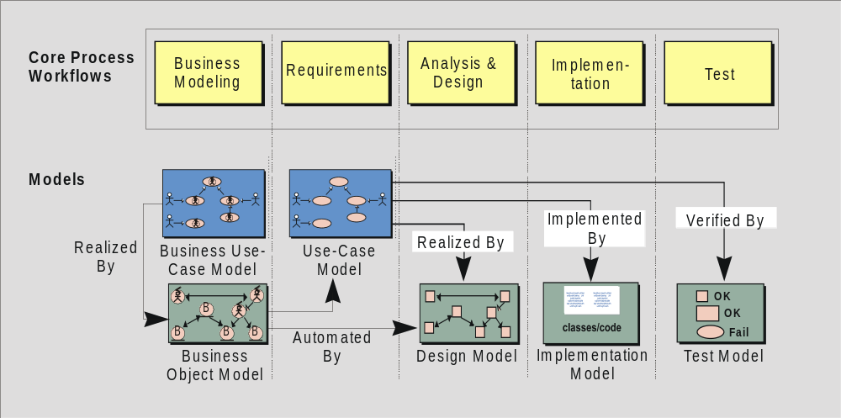
Workflows Produce Models
Notes:
The Rational Unified Process is a model-driven approach. Several models are needed to fully describe the evolving system. Each major workflow produces one of those models. The models are developed incrementally across iterations.
The Business Model is a model of what the business processes are and the business environment. It can be used to generate requirements on supporting information systems.
The Use-Case Model is a model of what the system is supposed to do and the system environment.
The Design Model is an object model describing the realization of use cases. It serves as an abstraction of the implementation model and its source code.
The Implementation Model is a collection of components, and the implementation subsystems that contain them.
The Test Model encompasses all of the test cases and procedures required to test the system.
You can relate this back to previous slides that describe the system model and the many diagrams needed to fully communicate its content. One can consider all of the models listed here, taken together, to be “the system model.”
The only model that is a little different is the business model. It describes the business at large, not just the automated part. The other models describe the information system that supports the business model.
It is a good idea to point out that each of these models is incrementally developed across many iterations.

Slide 56
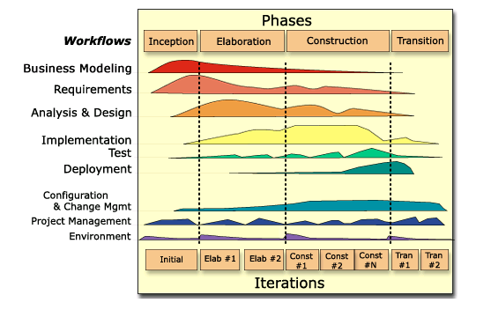
Bringing It All Together: The Iterative Approach
In an iteration, you walk through all workflows
Workflows group activities logically
Notes:
Can iterations overlap?
No. Our model is to show no overlap among iterations. In a large project, several teams may work in parallel on their portions of the iteration, but we do not consider these to be separate iterations.
How many iterations should you have?
It depends on many factors. Err on the side of too many iterations.
Animation note: The callouts and black rectangle appear 2 seconds after the slide.
This graphic illustrates how phases and iterations (the time dimension) relate to the development activities (the workflow dimension). The relative size of the color area indicates how much of the activity is performed in each phase/iteration.
Each iteration involves activities from all workflows. The relative amount of work related to the workflows changes between iterations. For instance, during late Construction, the main work is related to Implementation and Test and very little work on Requirements is done.
Note that requirements are not necessarily complete by the end of Elaboration. It is acceptable to delay the analysis and design of well-understood portions of the system until Construction because they are low in risk.

Slide 57
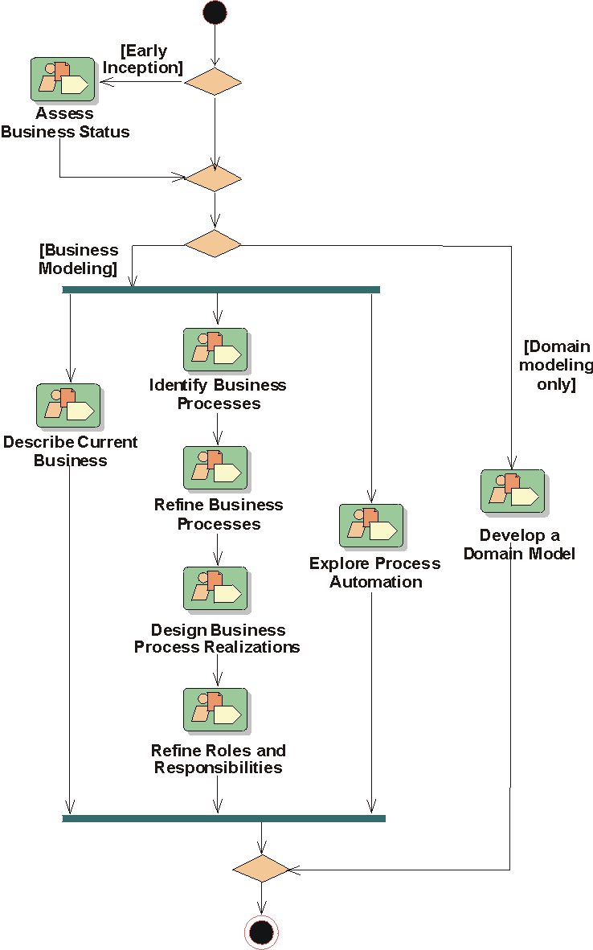
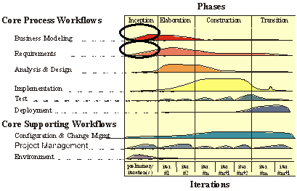
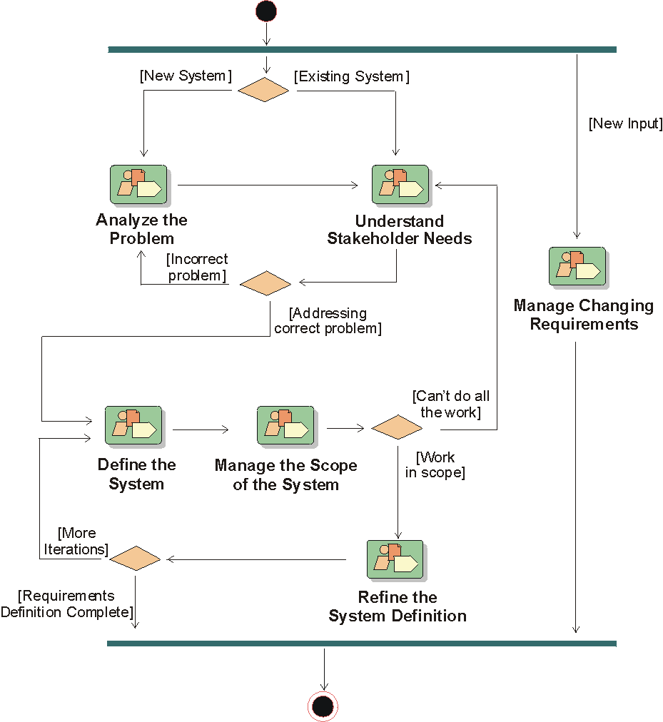
Workflows Guide Iterative Development
Business Modeling:
Workflow Details
Requirements:
Workflow Details
Notes:
An iteration workflow defines the workers, activities, and artifacts that are involved in a particular execution of an iteration in the software lifecycle. An iteration workflow will involve the core workflows in varying degrees, depending on the phase.
An iteration workflow activity diagram shows multiple possible sequences of workflow details. Generally a workflow detail is the lowest level represented.
Make clear that the iteration workflow will vary, depending on the phase, iteration location within a phase, and the technology being used. The Project Management and Analysis & Design workflows are good examples of this.

Slide 58
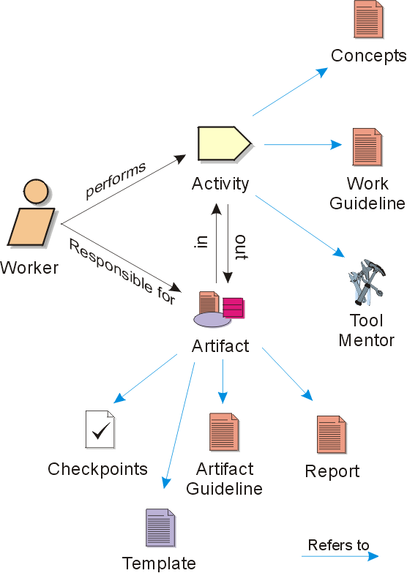
Overview of Rational Unified Process Concepts
Notes:
Static View of the Rational Unified Process
A worker defines the behavior and responsibilities of an individual, or a set of individuals working together as a team.
An activity is the smallest piece of work that is relevant.
Artifacts are the modeling constructs and documents that activities evolve, maintain, or use as input.
Artifacts:
A document, such as Business Case or Software Architecture Document.
A model, such as the Use-Case Model or the Design Model.
A model element, such as a class, or a subsystem.
Activities have checkpoints which are used to review artifacts.
Report Models and model elements, have reports associated with them. A report extracts information about models and model elements from a tool. A report presents an artifact or a set of artifacts.
Template -- There are a number of ready-to-use templates, which present documents and artifacts.
Tool mentor -- Most activities in the Unified Process are supported by software-engineering tools.
Guideline -- For most artifacts the Unified Process provides guidelines with detailed information about the artifact.
Work guideline -- Work guidelines contain practical information about the how to perform certain tasks.

Slide 59
Notation
A role that may be played by an individual or a team in the development organization
A unit of work a worker may be asked to perform
Activity
Worker
Use-Case
Describe a
Use Case
Specifier
responsible for
Artifact
A piece of information that is produced, modified, or used by a process
Use Case
Use-Case
Package
Notes:
This shows how the RUP represents the process graphically. The UML provides a notation for representing the artifacts of the process, but not the process itself. These conventions will be used in describing each of the workflows of the process.
An artifact is something you produce in the course of developing a software product. It includes the source code itself, as well as the models, documents, and other products of the lifecycle. The UML provides notation for representing many of the artifacts of the development process.
An activity is the smallest piece of work that is relevant. It is not reasonable to do only part of an activity. Dividing the work in this manner makes it easier to monitor development. It is better (easier) to know that the project has completed three out of five activities rather than 60% of one activity. Examples of activities are Plan an Iteration and Review the Design.
A worker defines the behavior and responsibilities of an individual, or a set of individuals, working together as a team. This is an important distinction because it is natural to think of a worker as the individual or the team itself. In the Rational Unified Process, the worker is more of a role that defines how the individuals should carry out the work. An example of a worker is a project manager.

Slide 60
Workers Are Used for Resource Planning
Resource
Paul
Mary
Joe
Sylvia
Stefan
Worker
Designer
Use-Case Specifier
System Analyst
Implementer
Architect
Activities
Define Operations
Detail a Use Case
Find Actors and Use Cases
Perform Unit Tests
Identify Design Mechanisms
Each individual in the project is assigned to one or several workers
Notes:
This is really standard resource allocation and should be familiar to all project managers and tech leads. The only point to be made is that typically the worker roles defined in the RUP do not correspond to the activities of just one individual (with the exception of the architect, perhaps). Otherwise, it is a many to many mapping.
In developing a project plan, a project manager assigns the individuals available to workers according to their skills and abilities. The project manager assigns each individual on the project to one or more workers. The association of individuals to workers is dynamic over time.
An individual may act as several different workers during the same day. We can informally call this “wearing several hats.” Sylvia may be both a design reviewer and a use-case designer.
Several individuals may act as the same worker to perform a certain activity as a team. Paul and Mary may serve as the use case designer for a single use case.

Slide 61

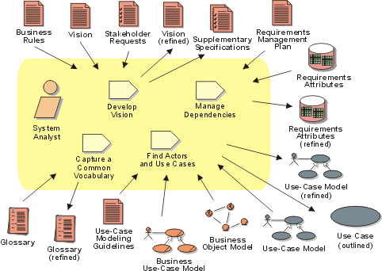
Workers Perform Activities and Produce Artifacts
Example-
Workflow Detail:
Define the System
Notes:
An artifact is a work product of the process: workers use artifacts to perform activities, and produce artifacts in the course of performing activities. Artifacts are the responsibility of a single worker, to promote the idea that every piece of information in the process must be the responsibility of a specific person. Even though one person may "own" the artifact, many other people may use the artifact, perhaps even updating it if they have been given permission.
The workflow detail diagram shows a set of activities that often are done ‘together’. It also shows input and output artifacts (indicated with arrows), as well as the workers involved.

Slide 62
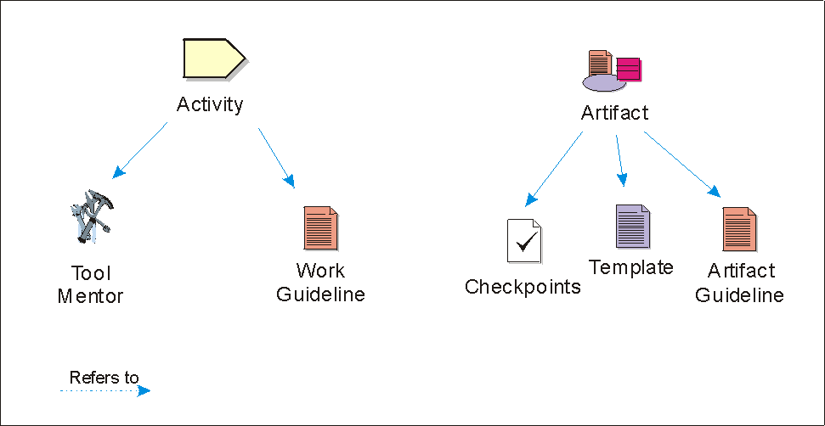
Process Guidance
For Performing Activities
For Producing Artifacts
Notes:
While we have focused mainly on the overall framework of the Rational Unified Process, i.e., the phases and workflows, the process provides much more technical and detailed guidance for the developer. Guidelines, tool mentors, and templates are used by developers on a daily basis to accomplish their technical tasks.
Guidelines, tool mentors, templates, and check-points make it easier to apply the process correctly and consistently.
Guidelines are the rules, recommendations, and heuristics that support activities, e.g., modeling and programming guidelines.
Tool mentors explain how to use a specific tool to perform an activity or steps in an activity, e.g., building a design model using Rational Rose.
Templates are predefined artifacts, e.g., a Rational SoDA template for a Use Case Report.
Check-points present information on how to develop, evaluate, and use the artifacts.
So far in this module we have focused mostly on the RUP framework, i.e., phases, activities, etc. But the process includes lots of more concrete benefits such as tool mentors and guidelines that appeal more directly to developers.

Slide 63
Enabling High-Performance Teams
Performance
Engineer
Analyst
Best
Practices
Project
Manager
Developer
Tester
Release
Engineer
+
=
Team-Based
Best Practices
Effective
Software Process
Team Success
Notes:
Using the Best Practices, each project will be incrementally better than the last.
Together, the Best Practices and process help unify your team to ensure they are working towards a common purpose, using a common set of techniques, methods, and guiding principles.

Slide 64
Summary: Best Practices of Software Engineering
Best Practices guide software engineering by addressing root causes
Best Practices reinforce each other
Process guides a team on what to do, how to do it, and when to do it
The Rational Unified Process is a means of achieving Best Practices

